Slide 1

Art Bible
Thumbsup!

Slide 2

Chapter 1:
Characters
Thumbsup!

Slide 3
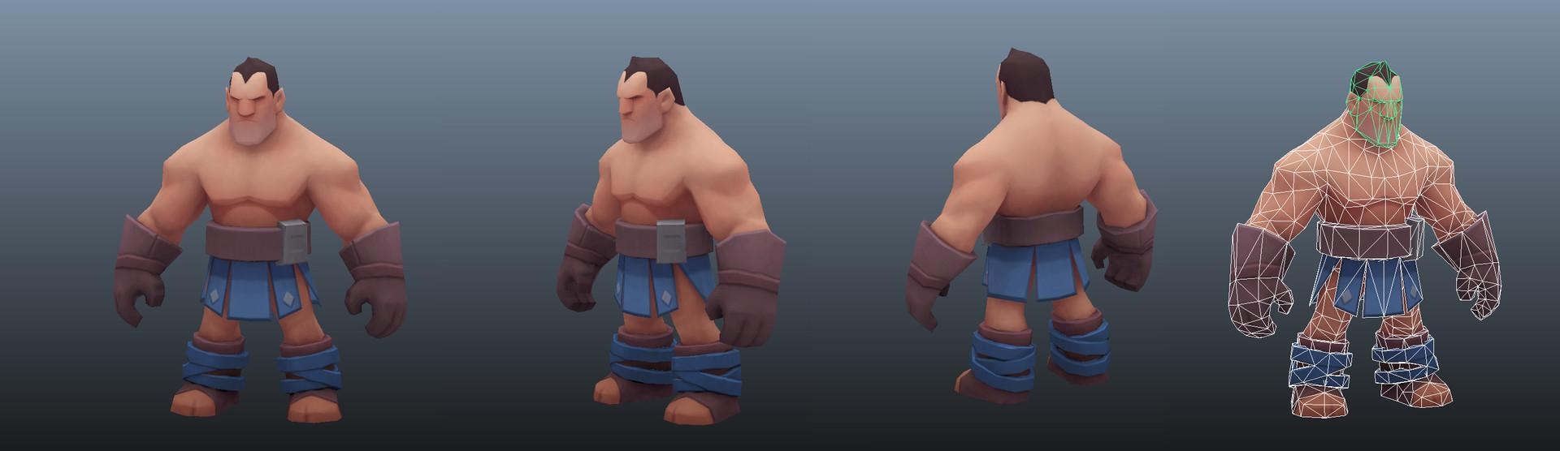
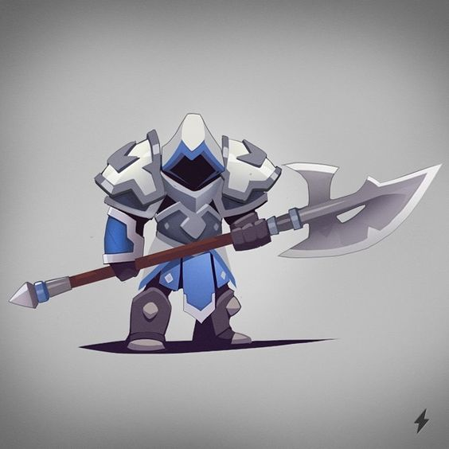
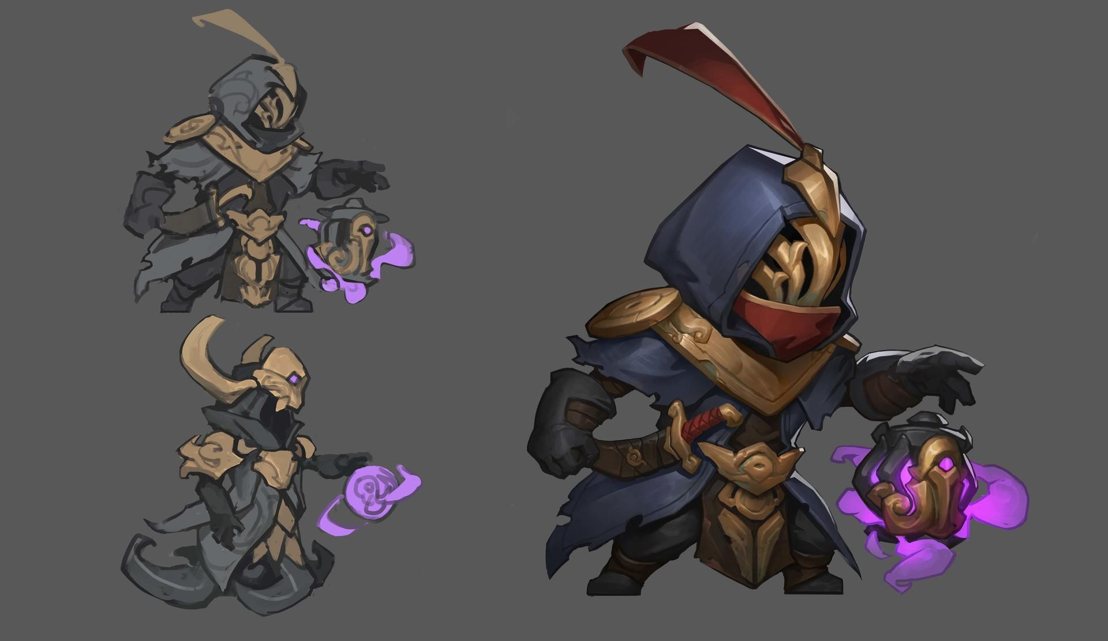
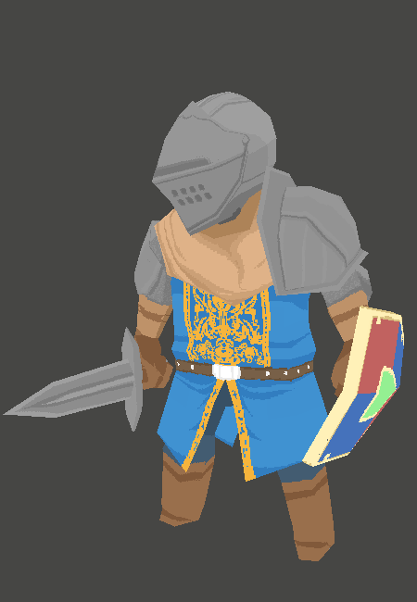
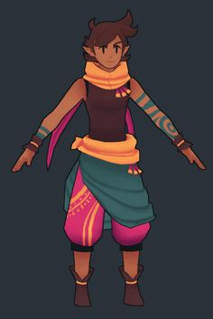
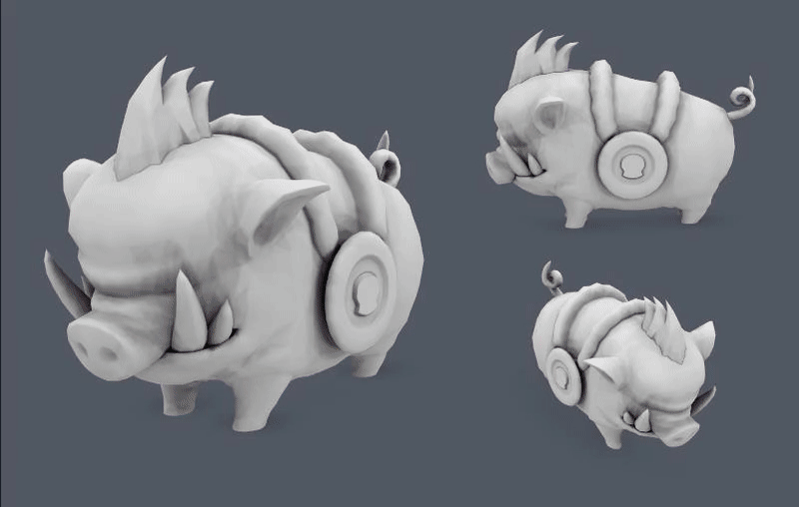
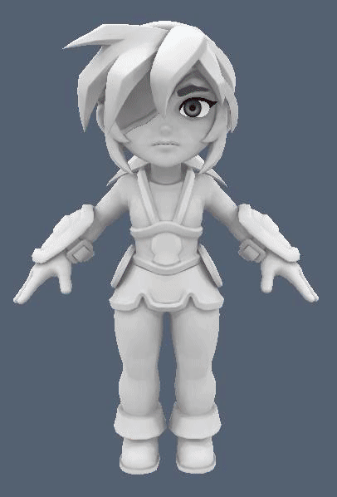
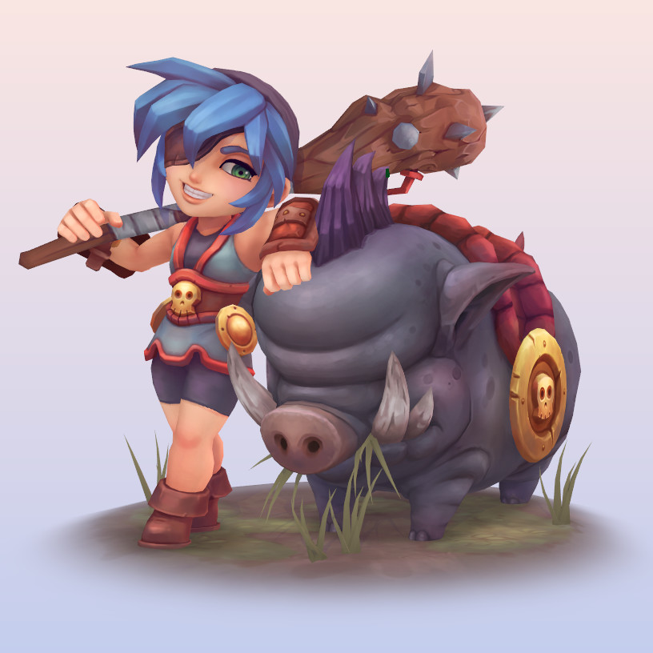
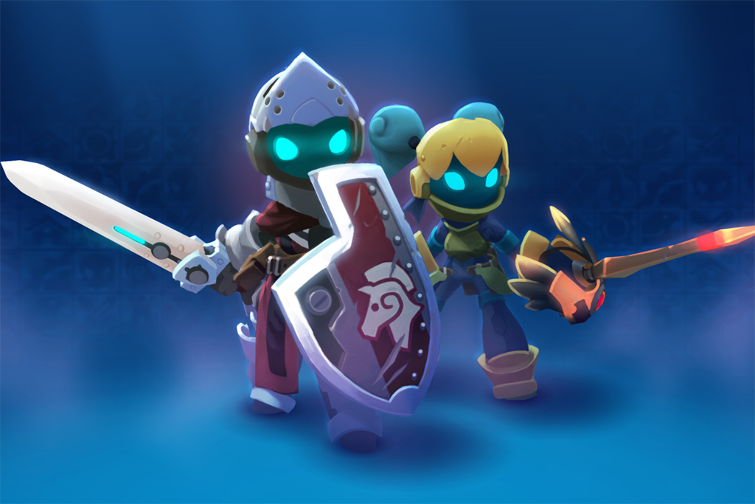
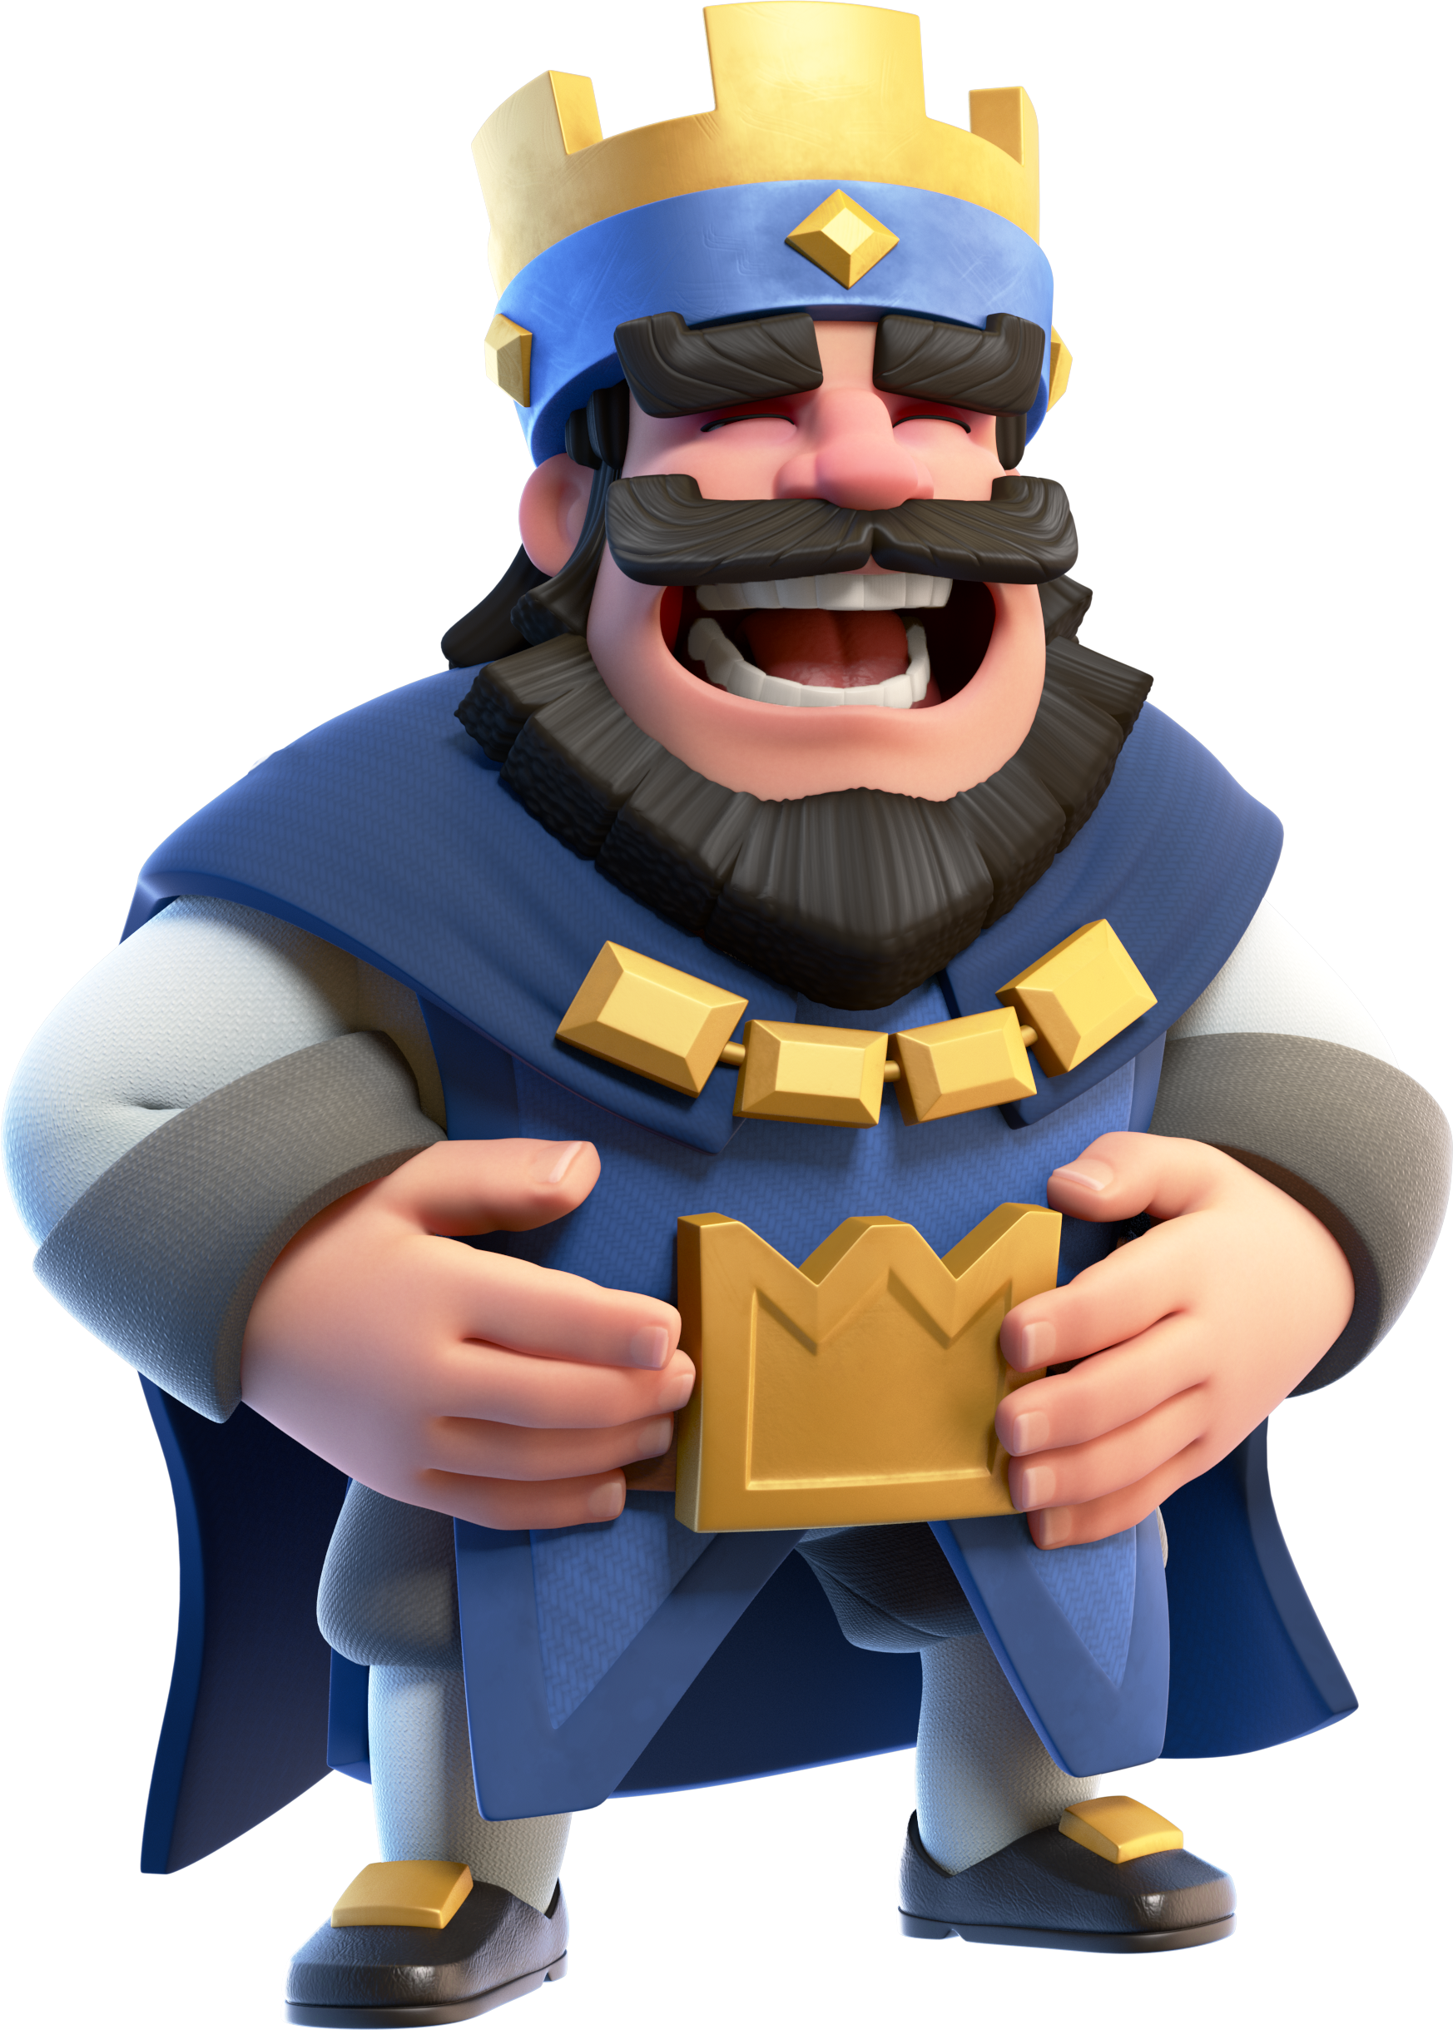
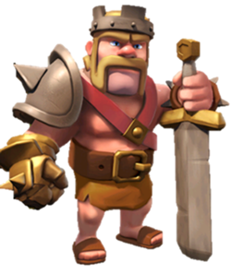
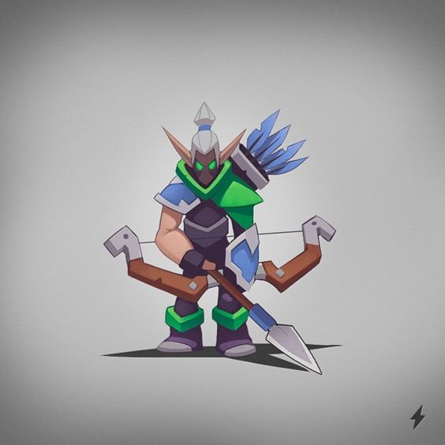
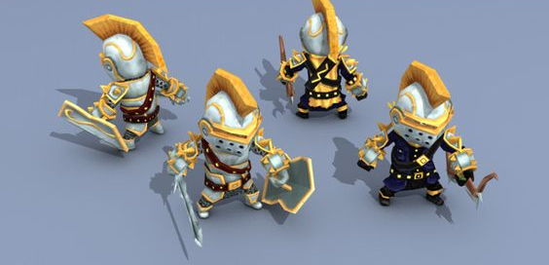
Heroes
The characters will have a cartoony aesthetics to them. Using low poly character meshes to help create the stylised aesthetic
Exaggerated proportions to create a much more interesting silhouette
Some cool/clean colours such as blues and reds to separate the heroes from the villains
Generally happy, mad, determined
Tank(Sweeper): Stocky builds, short, tough
Fighter(Striker): Thin, lanky, tall

Slide 4
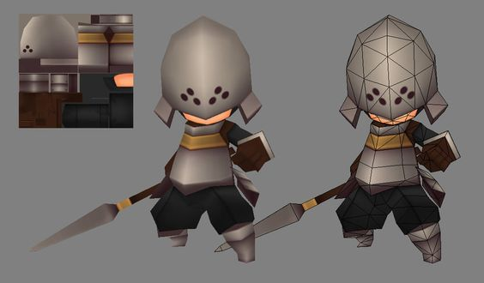
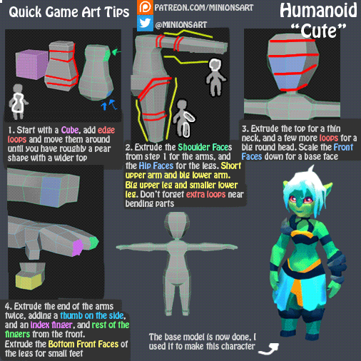
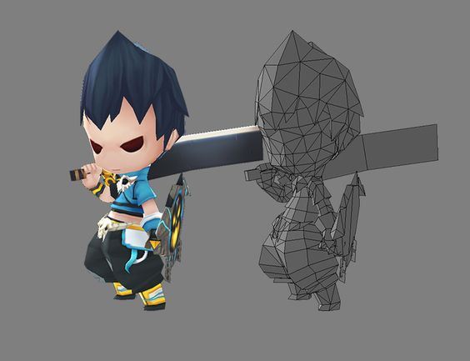
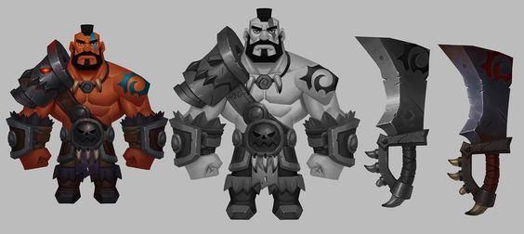
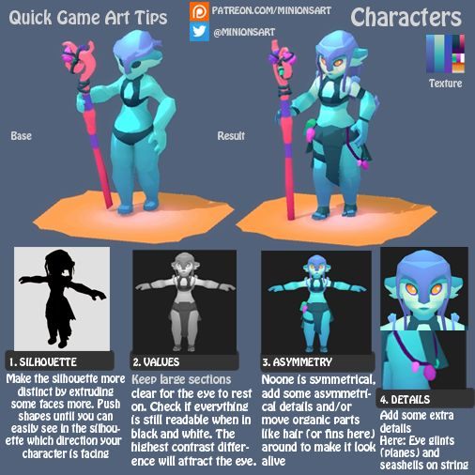
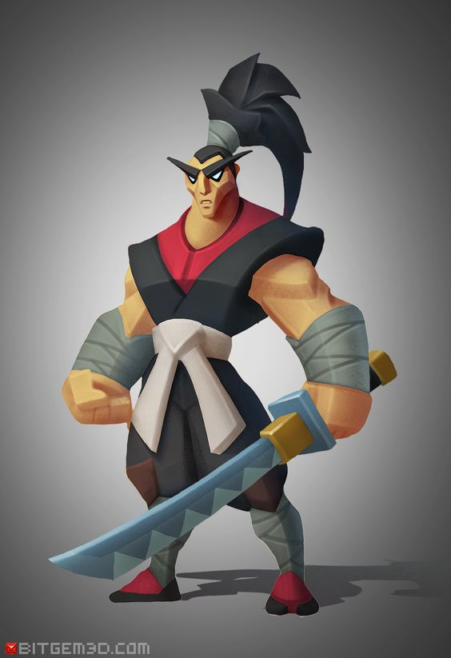
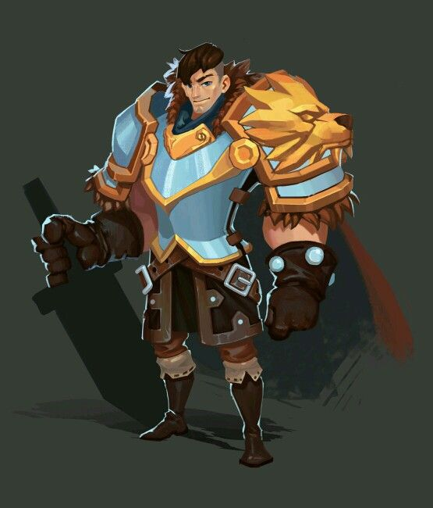
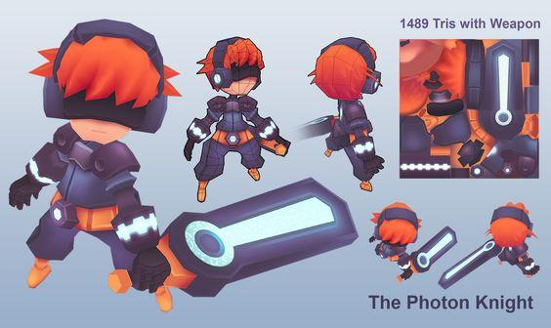
Heroes

Slide 5
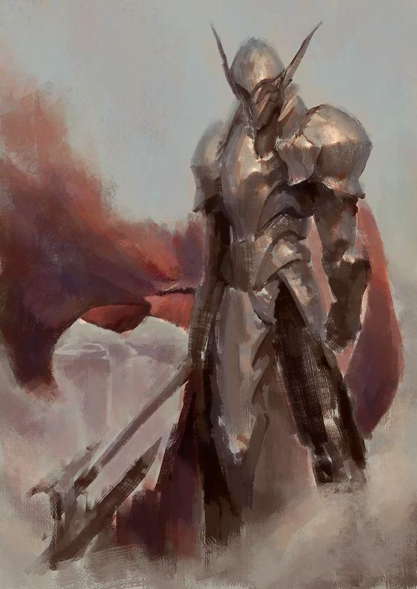
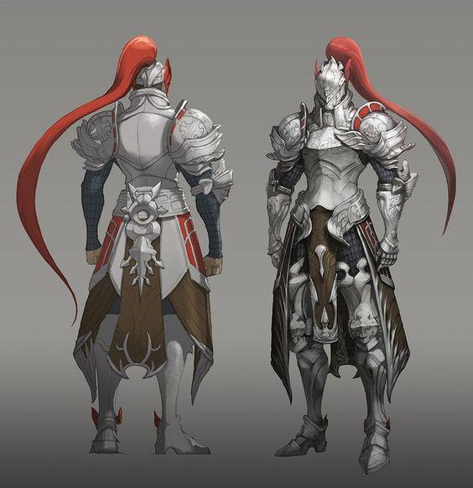
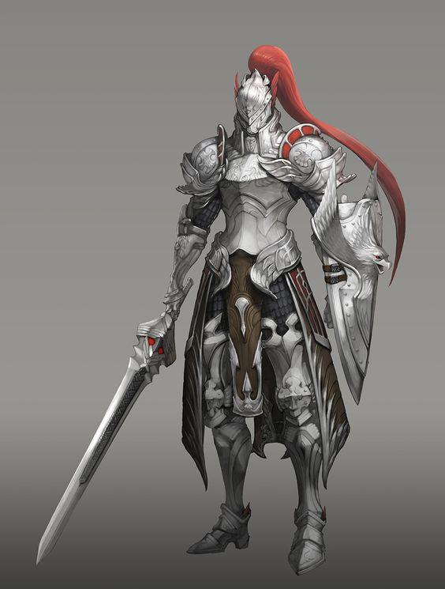
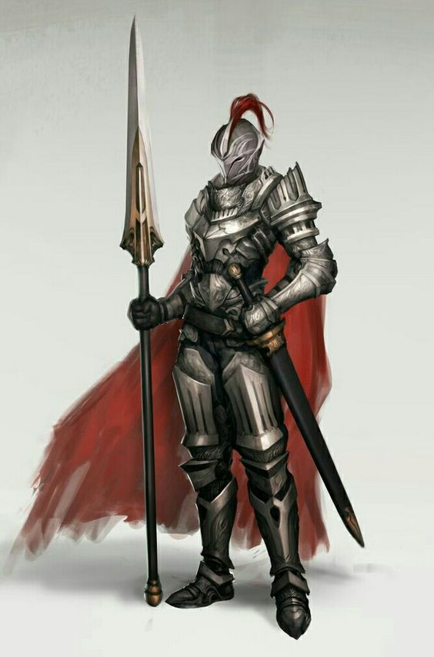
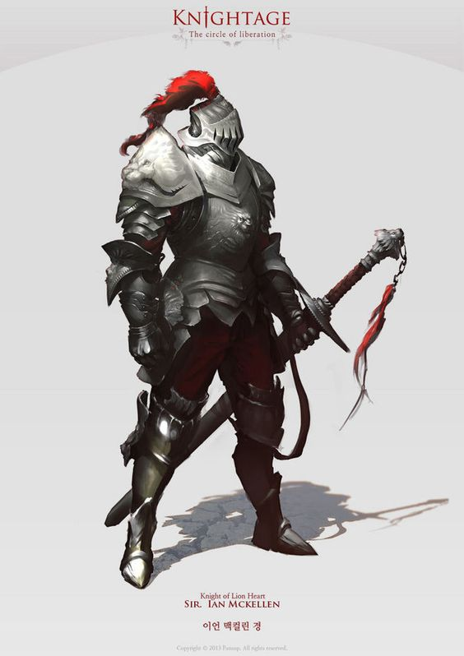
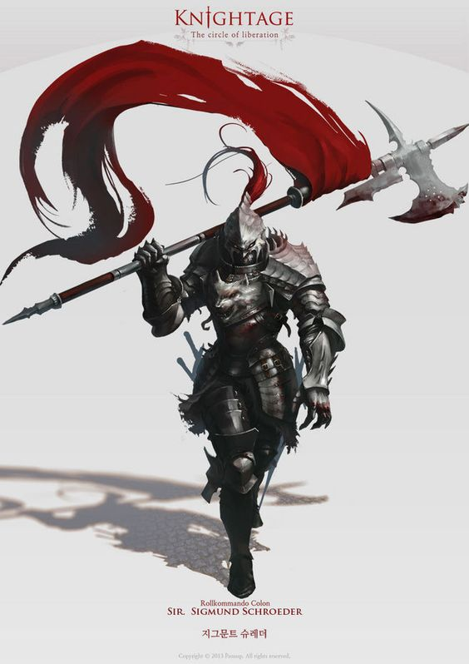
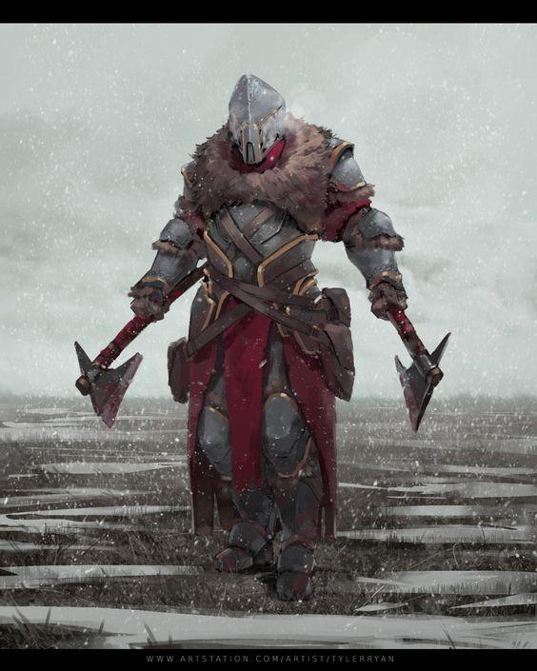
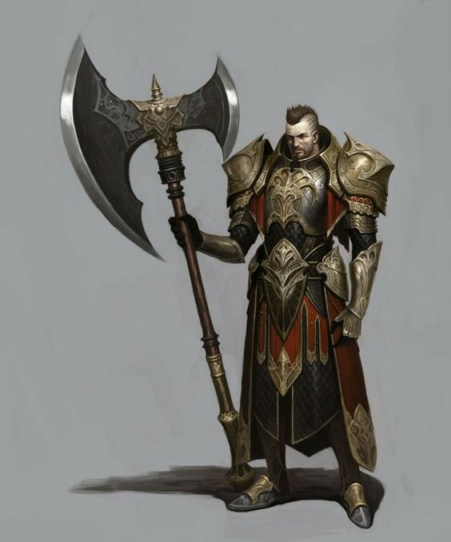
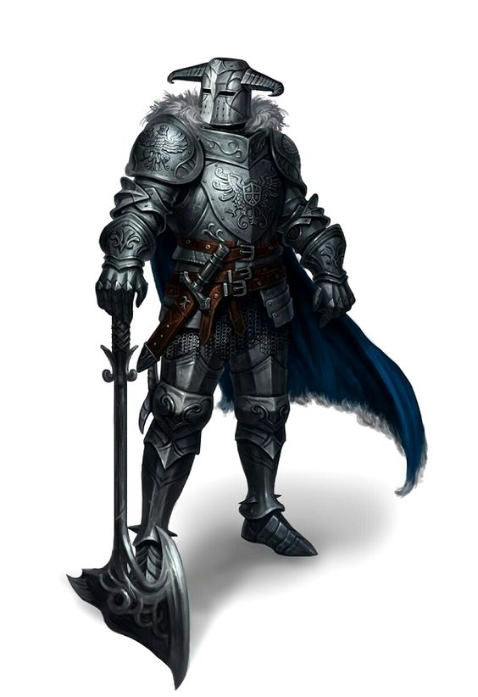
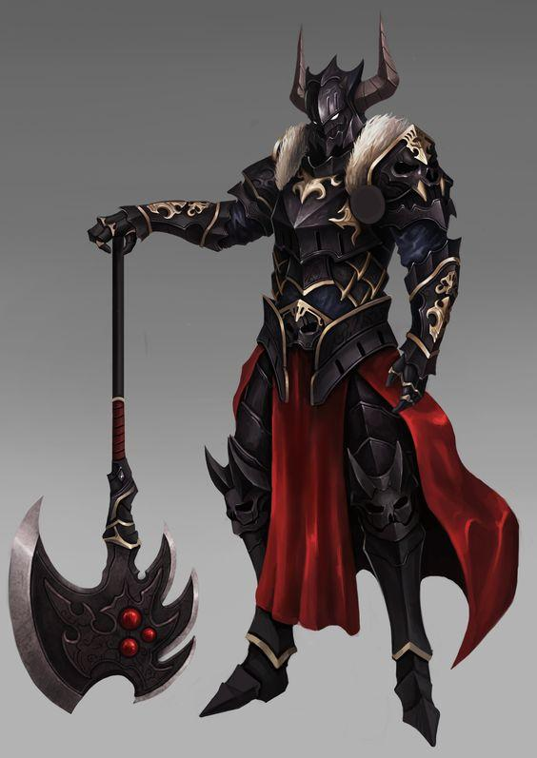
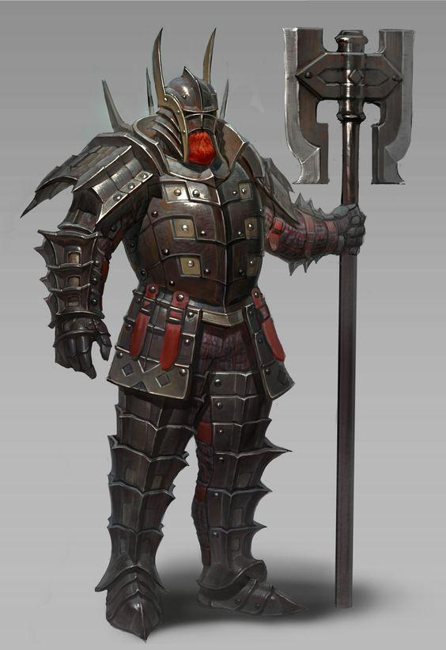
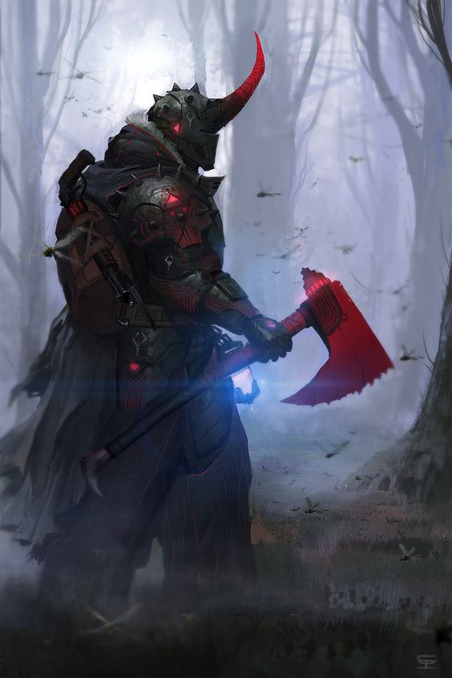
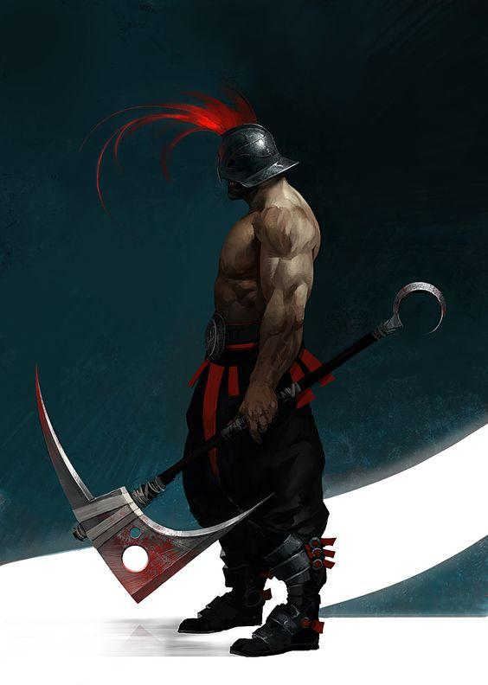
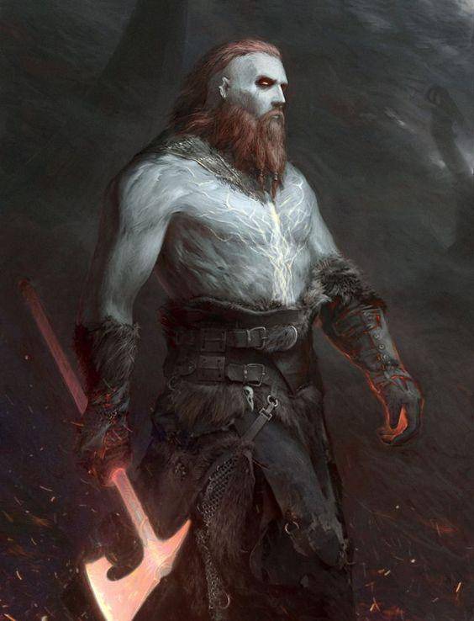
Sweeper(Hero)
Sweepers are heroes who wields an axe and cleaves his enemies who stands in his way.
The design for them would be heavily focus on brute force, heavy armoured knights.
The shapes would be upside triangle to get that bigger upper body as they’re strong but also slow.
The Sweeper colour is based around red as it suits the aesthetic of brute warriors.

Slide 6
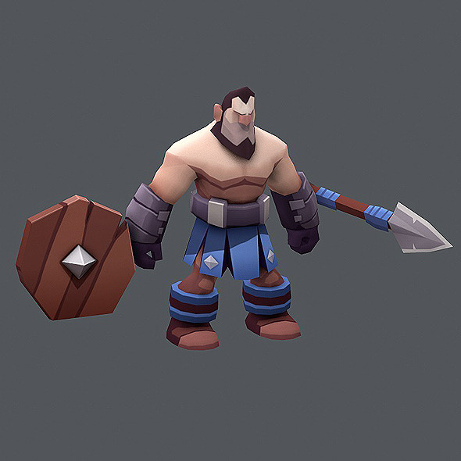
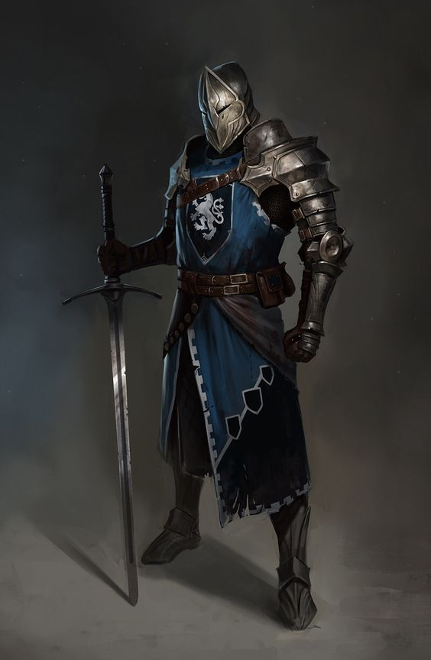
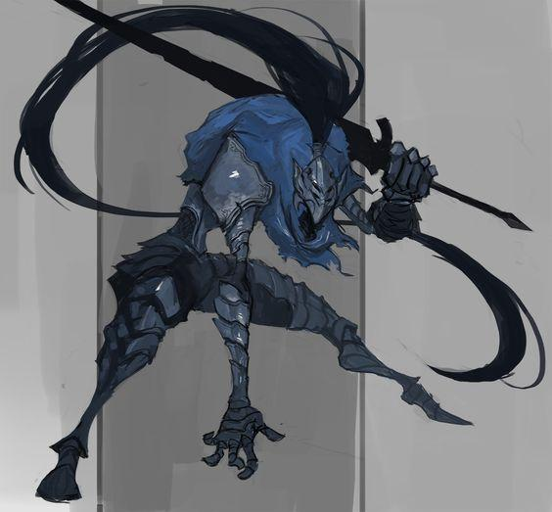
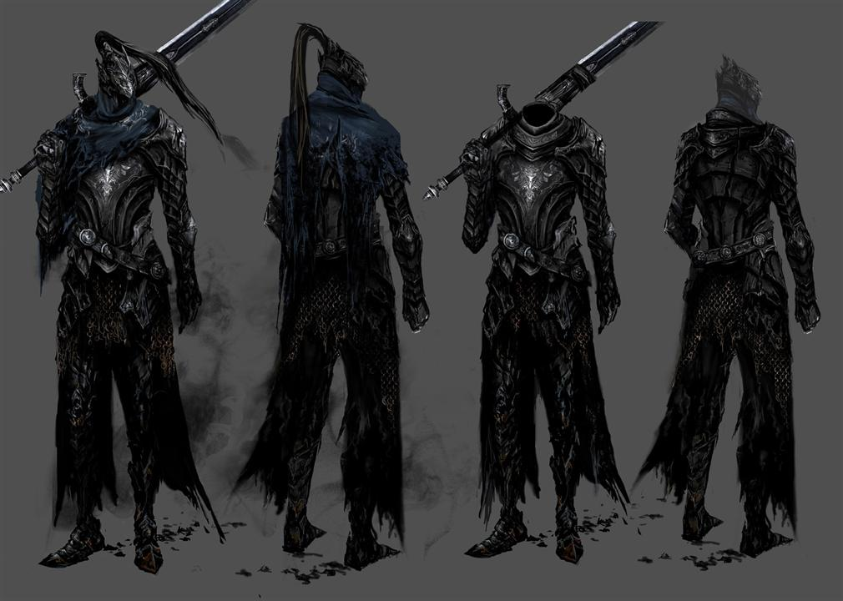
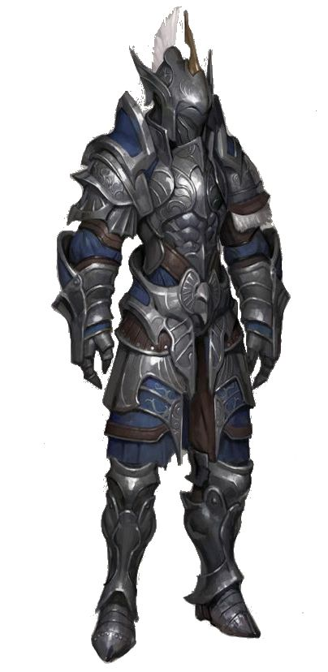
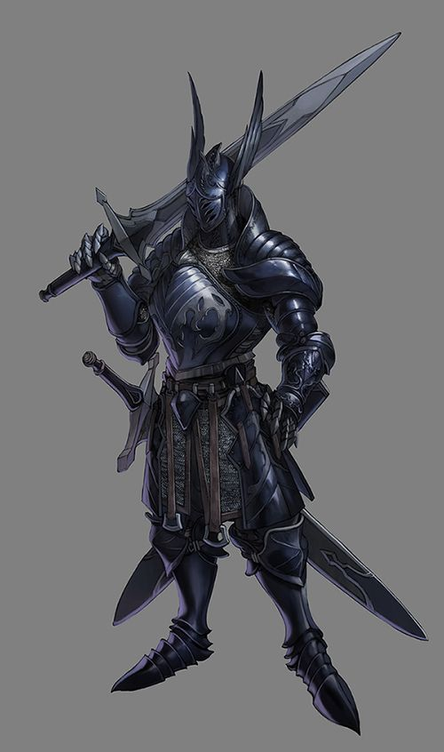
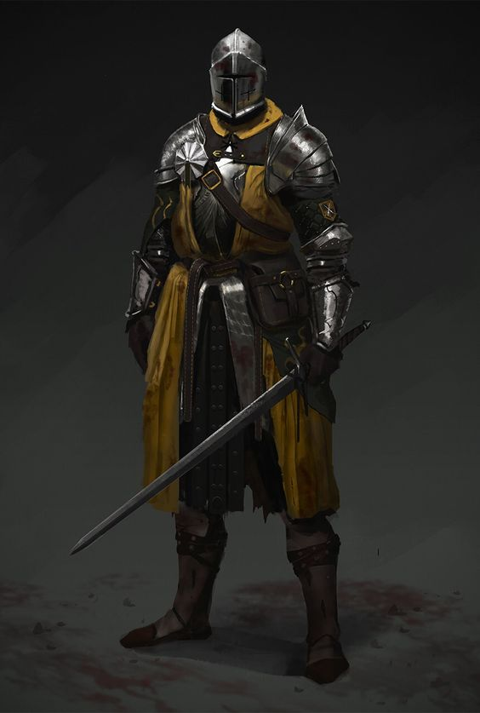
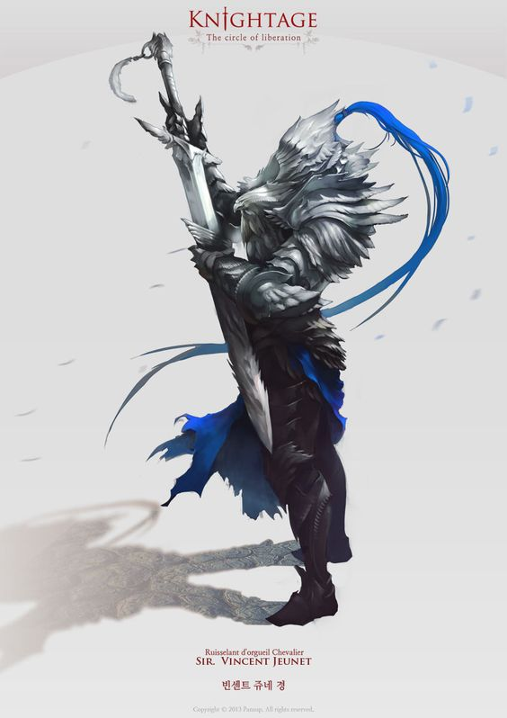
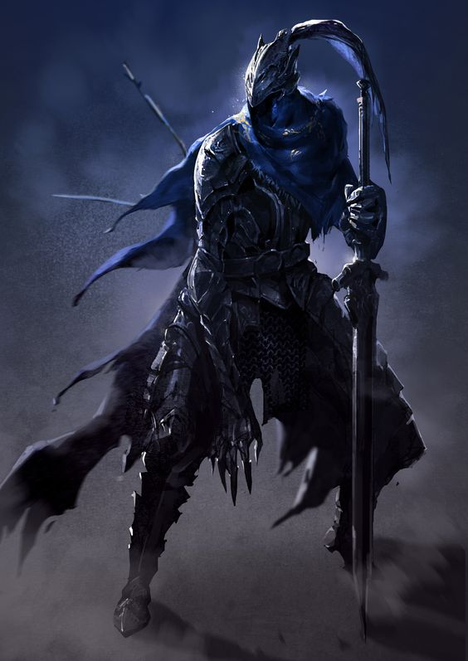
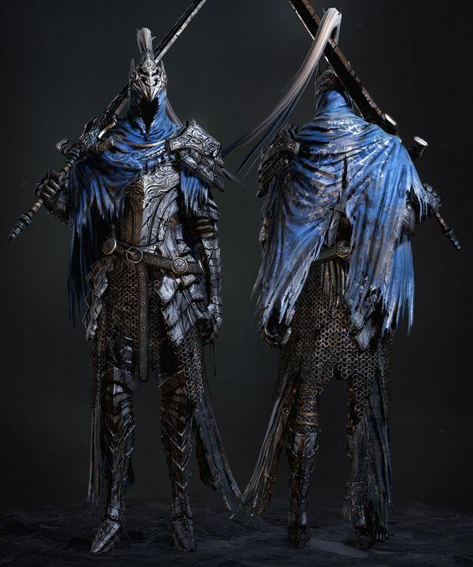
Striker(Hero)
Strikers are heroes who wields a sword to quickly strike through their enemies as well taking down bigger ones as they specialise in damage.
The design is more focused around light armour and a touch of mobility.
Shape of the character is slim as he is swiftly and mobile.
Strikers colour is based around blue as it shows he flows and zealous as he quickly get to big monsters and take them before they become a huge threat.

Slide 7
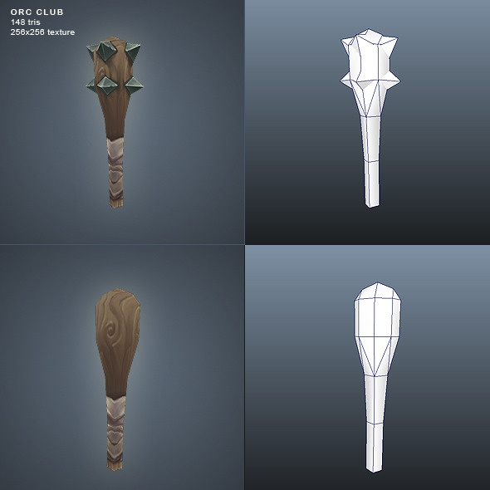
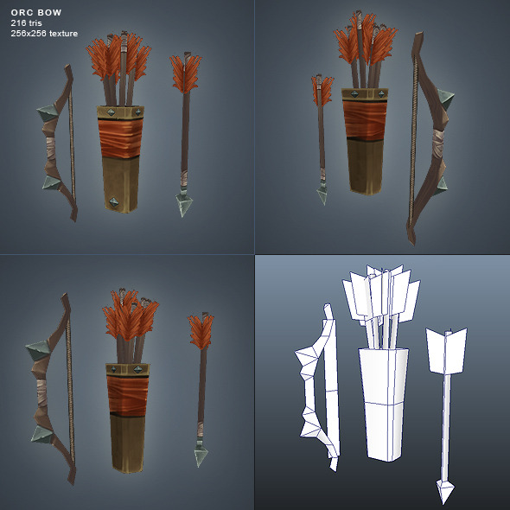
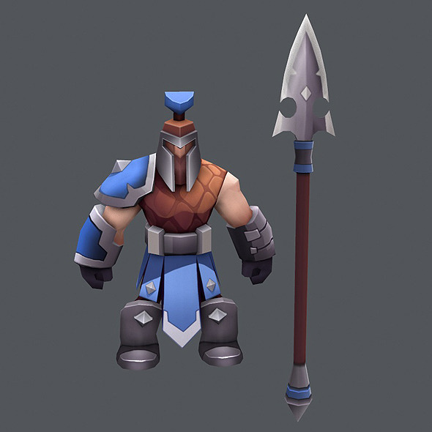
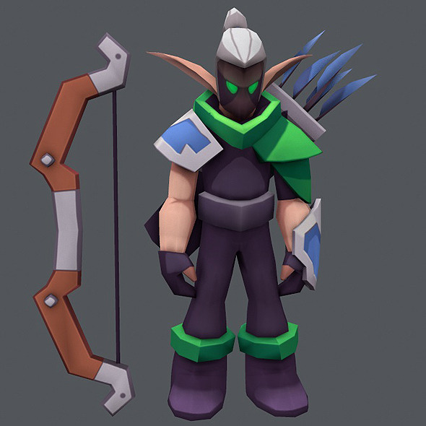
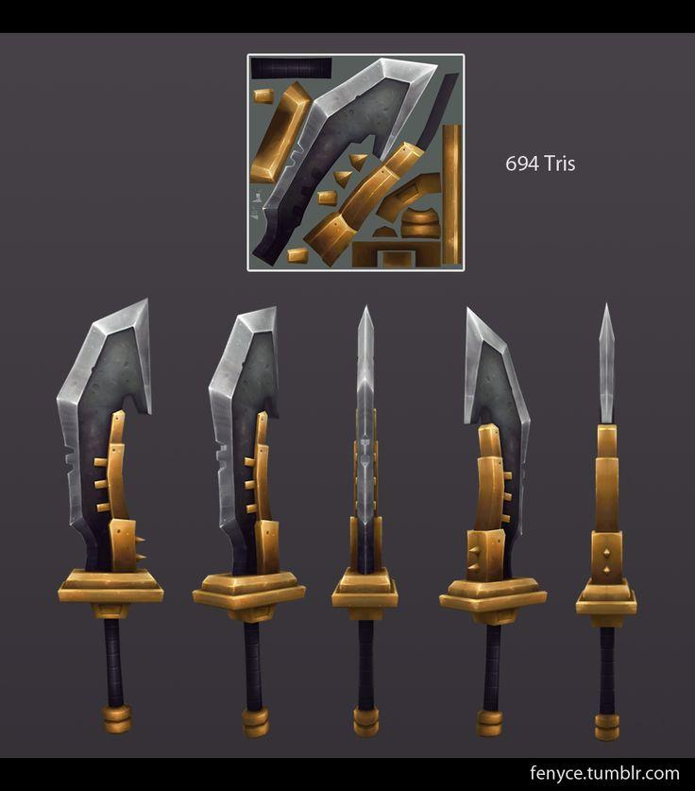



Weapons
Exaggerated proportions with low poly meshes help create the stylised aesthetic
Very blocked out colours and shapes A lot of steel materials to give the weapon more diverse shape
Exaggerated proportions also create much more interesting shapes for weapons, creating interest

Slide 8


Slide 9












Enemies
Avoid generic characters by exaggerating features, armor and clothing (eg. Skeletons, Orcs) Identify enemies by darker colour choices compared to heroes Tattered clothing and dark imagery to help sell the evil in the characters
Generally angry, sad, insane complexion

Slide 10



















Enemies

Slide 11






Bosses
Larger models than the rest of the enemies which communicates it’s big and strong
Doesn’t have to be too expressive, lack of emotion and empathy works well for a large scary leader
Unique details that makes them stand out than the minions

Slide 12

Chapter 2:
Environmental
Thumbsup!

Slide 13






Platforms
A semi blocky feel towards the platforms to flow with the cartoony aesthetics.
Heading towards a seamless layout like the spiral knights as to keep our game from looking geometric and more organic. Utilising more flat earth to help with the hack and slash mechanics and animations

Slide 14









Props
Simple low poly models with a pastel textured look and brightly coloured with high contrast to give the aesthetics of a cartoony look.
Our major inspiration for these props are Firewatch colours and supercell low poly models.

Slide 15








Props(Forest)
These props are the standard typical forest props with crates, wagon, barrels etc. laying around across the map.
The shapes of these props are exaggerated as well as the colour to give it a cartoony aesthetics as this game is only laid back game.

Slide 16











Props(Ruins)
Overgrown, ancient ruins to show that they have been here for many years and the enemies will follow a similar style.
Some props would have runes to give a magical feel.
The shapes of these props are exaggerated as well as the colour to give it a cartoony aesthetics as this game is only laid back game.

Slide 17

















Textures
These styles of textures all have similar effects that create the stylised aesthetic, mainly in it’s highlighting, colour choices and varied shapes to give it a fantasy look.
We’re going to apply gradient to all of the texture before we add in the details to create the cartoony, supercell and firewatch aesthetics.
Colour Palette/ Gradient
Soft Lighting/Highlights
High Contrasting Colours
Harsh Highlights
Varied Shapes
Harsh Highlights
Varied Shapes

Slide 18












Lighting/Atmosphere
Our game will be set in a forest theme as well leading towards Ruins theme.
The game will have somewhat nice vibrant colours to give of the cartoony feel as well dark atmosphere to connotes the dungeon like game.
The way we can communicate the dark atmosphere is through the misty and some heavy contrast in the shadows to give off the dungeon feel of it.
Our lighting will probably either warm colours or cool colours to also help communicate the dungeon like game.

Slide 19

Chapter 3:
Gameplay
Thumbsup!

Slide 20















Visual Effects
VFX will be colourful, thick and cartoony to go with the feeling of the rest of the game and do make it clear what is happening on screen based on the effects colour and weight.
The VFX for attacks like slashes and stabs will be dynamic and epic to give the player that satisfying pleasure as they attack monsters.
The dynamic VFX also flows well with the genre of hack and slash.

Slide 21










Animations
The characters will have dynamic and exaggerated animations for their movement and attacks. The exaggeration will make the characters interesting with the way they attack and move.
What we’re planning to do with our animation is have a separated animation for upper body and lower like a first/third person shooter but hack and slash.

Slide 22














U.I. (User Interface)
The UI will show the player's health meter, their special attack state (cooldown or ready) boss health and how much gold has been collected so far.
The UI will also be buttons to start the game and settings on the main menu as well as in game.
Our UI will have a cartoony look like mobile games as it’s easily readable as well matches the style we’re aiming for.

Slide 23








U.I. (User Interface)

Slide 24


Typology
The font that we’re leaning towards is more of a cartoony or comic like font as our game isn’t a serious type game.
Our game is more laid back and chill with your best friend as you guys hack and slash your way through the game.

Slide 25










Technical Details
UNITY
Ideal work process
Naming Convention
Concept
Modelling
Retopology/Skinning/Animation/unwrap
Texturing
Optional work process
Refining/ High poly
(Name_Teamname_Task_Stage)
Legacy Shaders On unity
Visual Effects
Programs

Slide 26

Key Art

Slide 27
The End

